Slide 1

XML Custom View
Jadara University
Faculty of Science and Information Technology
Done By:
Ali Khazaaleh - 201310198
Ammar Shatnawi - 201410248
Wala'a Athamneh - 201320131
Supervisor
Dr.Arwa Zabian

Slide 2
XML Custom View
web site that helps Android developers to create and custom view for their application in such an easy way and in short time, using by Android Studio or Xamarin Android form , this site will generate XML code only for the view, which they designed .

Slide 3
Android - UI
Android operating system (OS) for mobile, Android applications on Google play 2.7 M applications, developed for android with over 50 billion downloads.
UI User Interface is the screen that allows the users to interact with electronic devices through commands.

Slide 4
GUI - View
GUI Graphical user interface is type of user interface that allows users to interact through graphical icons and visual Elements.
View UI elements that are drawn on-screen including buttons, and lists forms

Slide 5
Custom view
allow android developers to change on exists view or execute full custom view to build new view.
Custom views are typically created to provide the user interface an experience

Slide 6
Custom view
The custom view have tow side :
First side custom view about default view (Button , TextVview , EditText ,RadioButton ,ChechBox)
Second side custom view about build new view (Button Buzzer ,Button Heart) programmatically by java .

Slide 7
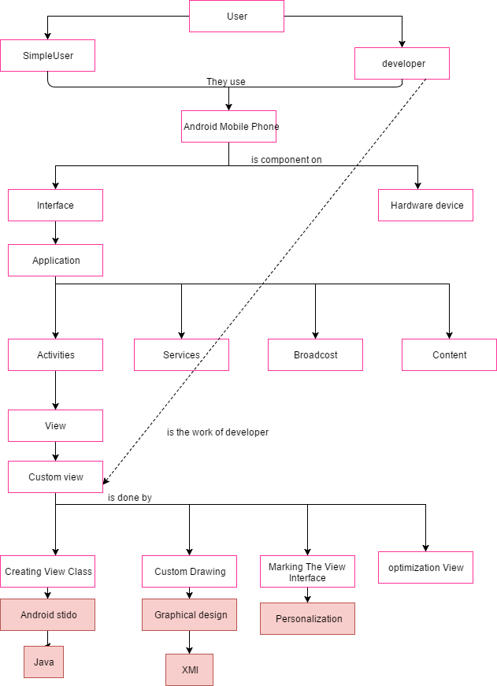
Path of project

Slide 8
Feasibility Study
Is custom view need time and special skills.
Does he want new site do more than other works ?
2 App (1-2) H / (0-1) H.

Slide 9
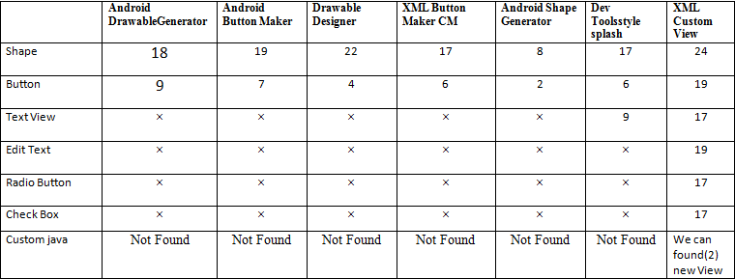
Related work about custom View

Slide 10
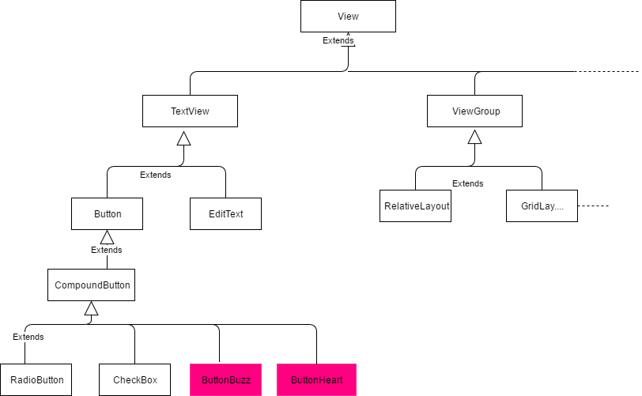
ButtonBuzzer and ButtonHeart

Slide 11
video
Video ButtonBuzzer , ButtonHeart .

Slide 12
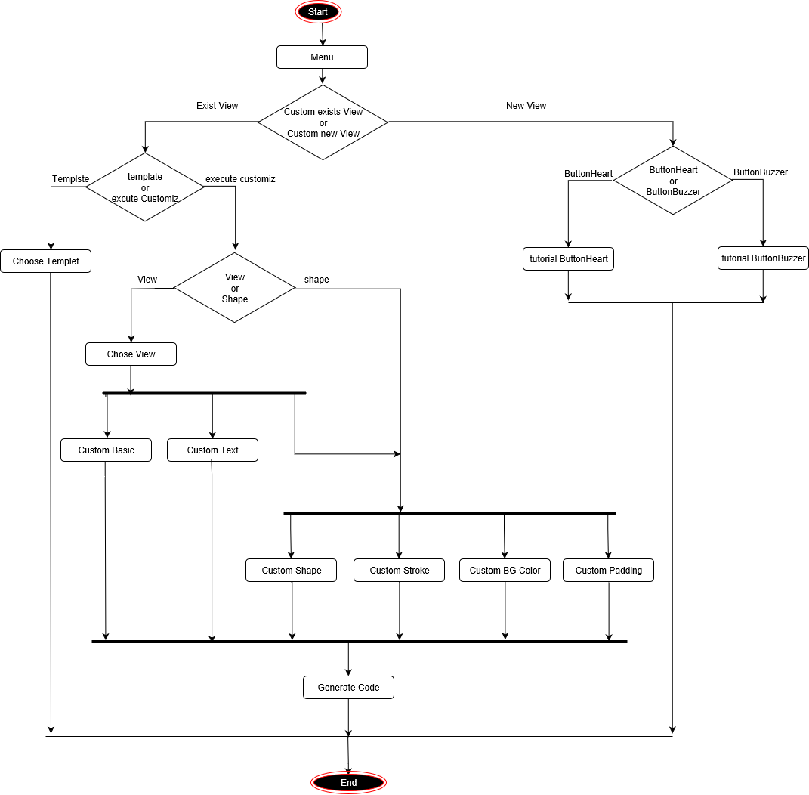
Activity Diagram

Slide 13
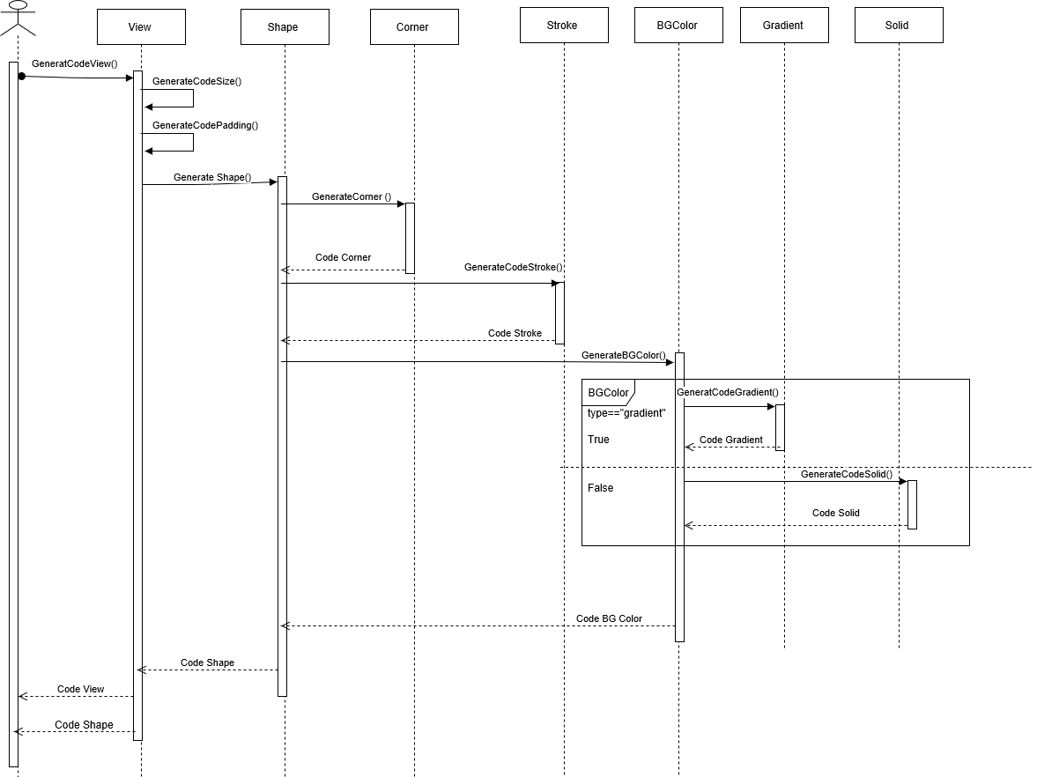
Sequence Diagram How Generate Code ?

Slide 14
Video About Site

Slide 15
Thank You

